Slide 1
Supporting your child’s learning at home.
Aims:
How we learn…
Maths strategies
Spelling strategies
Reading strategies
Writing strategies

Slide 3
Develop a Healthy Mindset
A healthy mindset towards learning maths includes self-belief, confidence and the resilience to keep learning even when it gets tough .
Start with yourself and your partner - are you setting a good example? Throw away remarks like “I’m not good at maths,” “I hated maths at school” etc. are picked up by children, influencing their attitude to maths. So show enthusiasm towards maths - even if you need to fake it!
• Build confidence
• Praise for effort, not performance
• Keep your little learner motivated
Notes:
Build confidence - if your child is struggling and has lost some confidence, go back a few steps to the skills that they feel comfortable doing and build from there.
Praise for effort, not performance - it’s continued effort that is important. Making mistakes isn’t bad, it’s a necessary part of the journey for every learner. Change “I can’t do it,” to “I can’t do it yet.”
Keep your little learner motivated - a key role (and challenge) for parents, help them to learn that maths is purposeful with real life examples.

Slide 4
3 STRATEGIES FOR LEARNING
Concrete
Pictorial
Abstract
‘Can you tell me what the answer to 3+3 is please?’

Slide 5
Maths Essentials
Counting forwards and backwards across a multiple of 10
Number Bonds to 10, 20 and 100
Times Tables
Doubling
Halving
Sharing
Estimating
Mathematical vocabulary
Telling the time
Notes:
Supporting children at home

Slide 6
Maths at Home
find numbers around your home and neighbourhood – clocks, letterboxes, speed signs
use mathematics words during play (treasure hunts, obstacle courses, building huts) - "under', "over", 'between", 'around", "behind", "up", "down', "heavy", "light', 'round", "your turn next", "before", "after", "left" and "right", "square", "triangle" – you can use your first language
helping at the shops – ask your child to get specific items (medium-sized tin of red beans, 2 litres of milk, 250g of mince).
making lunch or a meal for a party – make sandwiches in different shapes. Can they cut their sandwich in half? Can they cut the other sandwich in half a different way?
helping at the supermarket – choose items to weigh – how many apples/bananas weigh a kilo? Look for the best buy between different makes of the same items (e.g. blocks of cheese) – check on the amount of sugar or salt per serving
look through junk mail – find the most expensive and cheapest item advertised

Slide 7
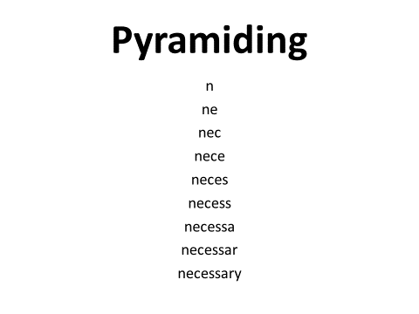
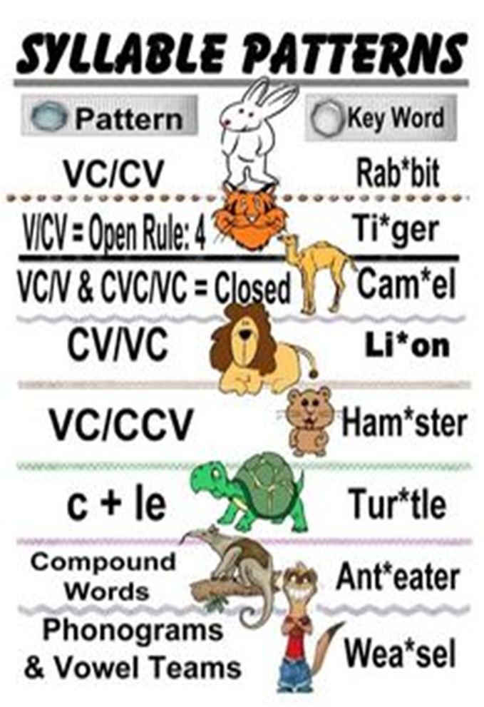
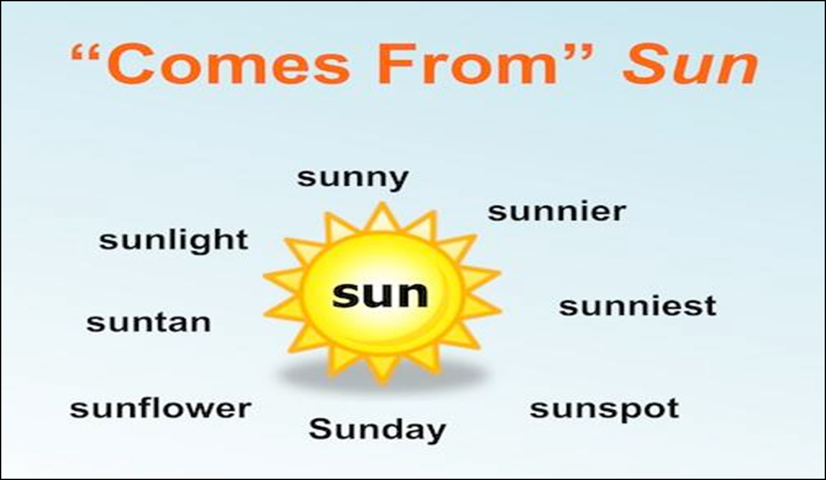
Spelling
T triple C Trace – Trace the word 3 times saying the letters as you write them. Copy – Copy the word 3 times looking at the model. Cover – Write the word 3 times without a written prompt. Closed – Write the word 3 times with eyes averted or closed. |  | SOS Tutor says the word. Student repeats the word. Student segments phonemes in word. Student says each phoneme naming the letters. Student writes each phoneme naming each letter as he writes it on paper. Student reads the entire word he has written. Root Words

Slide 8
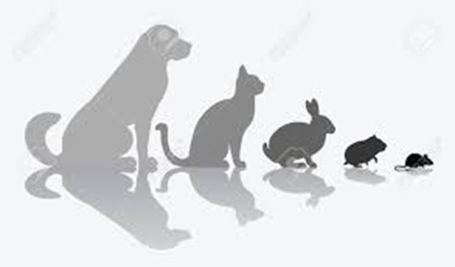
Reluctant Readers
No reading – talk about the pictures | No reading – describe something in the picture for the child to guess, swap roles | No reading – Look for things that are small, large, under, above, next to, behind etc.
No reading – I spy with my little eye, something in the picture beginning with…. Swap roles | No reading – I spy with my little eye, something in the picture beginning with the digraph …… Swap roles | No reading – I spy with my little eye, something in the picture ending with the digraph …… Swap roles
No reading – I spy with my little eye, something that rhymes with…. Swap roles | No reading – I spy with my little eye, something that is the opposite to…. | No reading – I spy with my little eye, something that has the same sound, at the beginning, as….
No reading – I can see a dog; it is small but the mouse is smaller. Swap roles | No reading- Look at the pictures; what do you think will happen next? Why do you think that? | No reading – This boy is at the ……. Do you remember when we went to …? What did we see? What did we do? Was it a good day? What did/n’t you like about it?
Detective skills – Find the words beginning with a capital letter. Is it a name, the beginning of a sentence or both? | Detective skills – Find the high frequency word …….. How many did we find? | Detective skills – Find the pronouns; he, she, we etc.

Slide 9
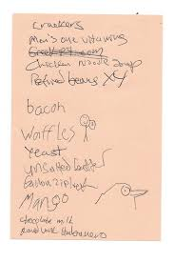
Writing
Don’t worry if your child’s letters or words are sometimes backwards or misspelt at this age. The important thing is that they have fun writing at home and are making an effort.
Write to each other. Write notes to your child and leave them in interesting places, like their lunch box. Ask them to write a reply
Help them email, text or write to family or friends
Work with them to put labels on special things – like the door to their room or their toy box.
Talk a lot to your child while you are doing things together. Use the language that works best for you and your child.
Write lists – ‘Things I need from the shop’, ‘Games to play when I am bored’, ‘Things I want to do in the holidays’. The last one can be cut up and go into a box or bag for a lucky dip when the holidays finally arrive

Slide 10
Thank you for listening
School will be given lists of strategies that they can disseminate in due course.
clair.colton@achievingforchildren.org.uk

